Slide 1
Data Testing Framework Overview
Notes:
Month dd, yyyy
Presentation Title
0

Slide 2
Data Testing Framework Description and Benefits
What is the Data Testing Framework?
An automated Testing Solution which provides:
Comparison of any two datasets, commonly known as source to target or expected and actual
Detailed reporting for efficient data analysis
Creation and execution of tests in ALM
Data Testing Framework Benefits:
Reduces execution time
Improves data coverage
User friendly excel based input
Ability to use parameters and on demand based executions
Ability to compare disparate sources, including file types (xml, flat, csv, xls, delimited) and database types (Oracle, Sybase, Sql Server and Netezza).
Easy to read email reports
No additional costs involved
No tools or licenses required
No data constraints or volume limitations

Slide 3
Testing Supported by the Framework
Types of Testing to Implement in the Framework
Comparison types: SQL, XML, Excel, File, Table - any combination of the two
Physical Data Model to Data Dictionary to Mapping (common first step for data testing)
Waterfall or Agile
Real-time or Batch
Subset or Full Volume
Progression and Regression
Uses for the Data Testing Framework
Development – leverage for unit and integration tests
System Test – leverage for validations on control data and/or full production data sets
User Acceptance Test – execution of business validation queries and compares
Production Validations – use daily/monthly to proactively identify data issues and errors

Slide 4





Framework Overview – High-Level Process Flow
Information:
ALM, Comparison Key, Datasets
Test Approach:
Organization, Parameters, Full Volume, Control Data, Data Prep, Convert Docs to Well Designed Tests
DTF Team
DTF Template
Tester
ALM:
Create and
Execute Tests
Generate Reports
Execute Comparisons
DTF

Slide 5
Framework Overview – Excel-Based Input Template
Component Name (No Spaces) | Test Case Number | Comparison Type (ExpModeActMode - S for SQL, T for Table, F for File, X for Xml, E for Excel) | TestSet Name | Comparison Keys (Separate with Commas and there should not be any spaces in Column names) | Expected Input (File info - for F mode Table Name - for T mode SQL Select Statement - for S mode INPUT_FILE:<<file name dropped in Inbound DIR>>) | Actual Input (File info - For F mode Table Name - for T mode SQL Select Statement - for S mode INPUT_FILE:<<file name dropped in Inbound DIR>>)
LN_UPB | 1 | SS | DAY1 | ast_id | select * from ${EXP_SCHEMA}.asset where DATE_CONition=${RUN_DATE}; | select * from ${ACT_SCHEMA}.asset_1
LN_FEAT_CD | 2 | SS | DAY2 | ln_id, aqsn_dt | select ln.* from ${EXP_PROD_SCHEMA}.wm_mtg_ln_aqsn ln where ln_id in (1705370853,1694226677) | select ln.* from ${ACT_PROD_SCHEMA}.wm_mtg_ln_aqsn ln where ln_id in (1705370853,1694226677)
Test Name
Comparison Key Information
Type of Comparison
Expected Result Details
Grouping Indicator for Test Case Organization in ALM (Test Set)
Actual Result Details

Slide 6
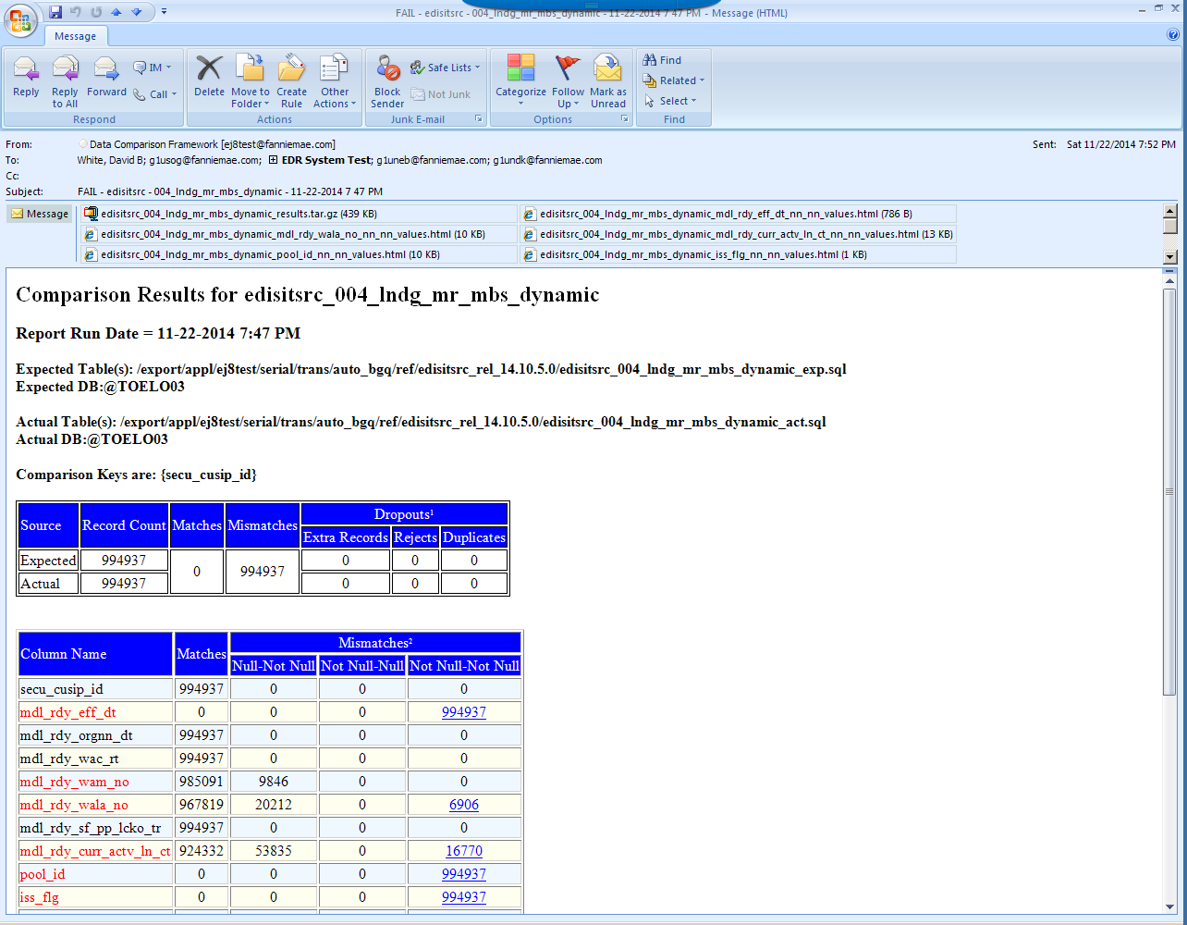
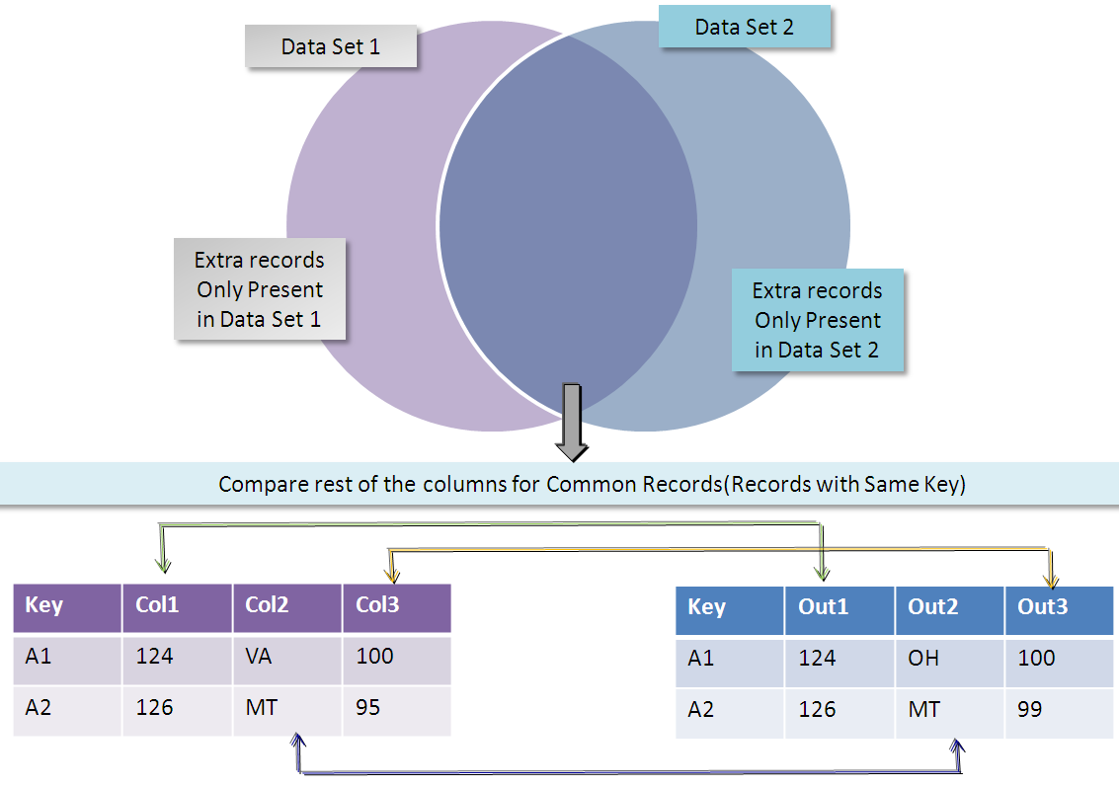
Framework Overview – Comparison Reports
How Comparison Works

Slide 7
Data Testing Framework – SMDU Experience
Problem Domain:
The data in the existing Transaction DB and Reporting DB were being reconciled and consolidated into a single database.
Test Strategy:
1. Compare data in Reporting and Transaction DBs against baseline data deployed in a separate environment.
2. Compare data between reporting and consolidated database.
ROI of 210% was realized, and testing coverage expanded from 10,000 data points to 8 billion data points.
Comparison: Automated Versus Manual Execution
Task | Duration (Hrs) Manual (10 K records) | Duration (Hrs) - Automated (8 Billion Records)
Test Planning | 75 | 22
Query Execution and Data Comparison | 78 | 15
Results Analysis | 26 | 26
QC Execution | 26 | 1

Slide 8
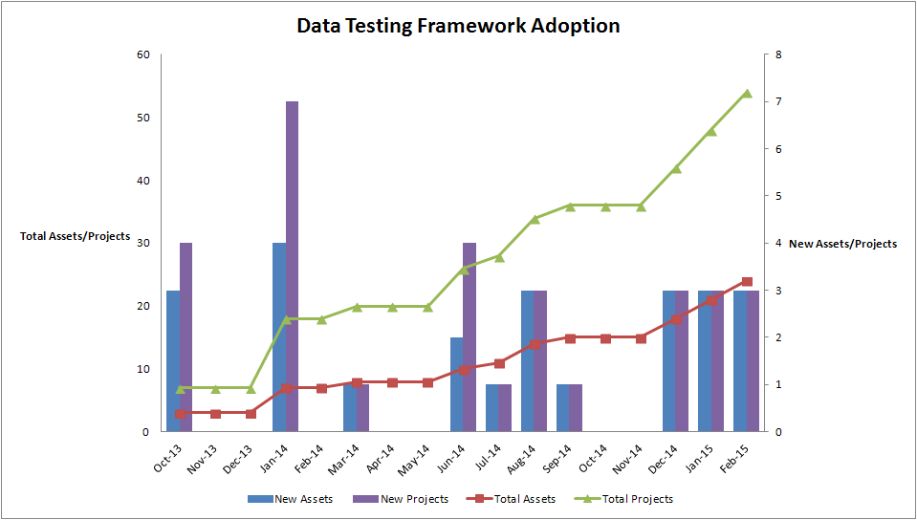
Data Testing Framework – Growth

Slide 9
POC and Support Team
Email Support
Data Comparison Framework Distro
Director
Carla Beichner
Team
David White
Sreedhar Guda
Nirmala Bethinapatla

